Slide 1
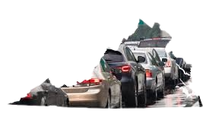
The State of Virginia Vehicle Crash Data Analysis From Year 2020 to 2022
By Selamawit Mekonnen
2024

Slide 2

Data questions?
How has the frequency and severity of crashes varied over time?
Are there distinct patterns in crash occurrences and severity based on the age groups of those involved (senior vs young)?
What are the external factors to crashes in Virginia, such as speed, alcohol, bike, distracted, 'drowsy, drug, ‘hit and run, large truck?
What are the primary contributing factors to crashes in Virginia
What are the differences in crash pattern and severity based on the presence of work zones and school zones?
Investigate the types of collision, the number of vehicles involved, and factors such as weather condition, road surface, and assess if these factors vary based on area type urban/rural classification.
What is the distribution of fatality rate across Virginia counties, and which counties exhibit the highest fatalities rate?

Slide 3
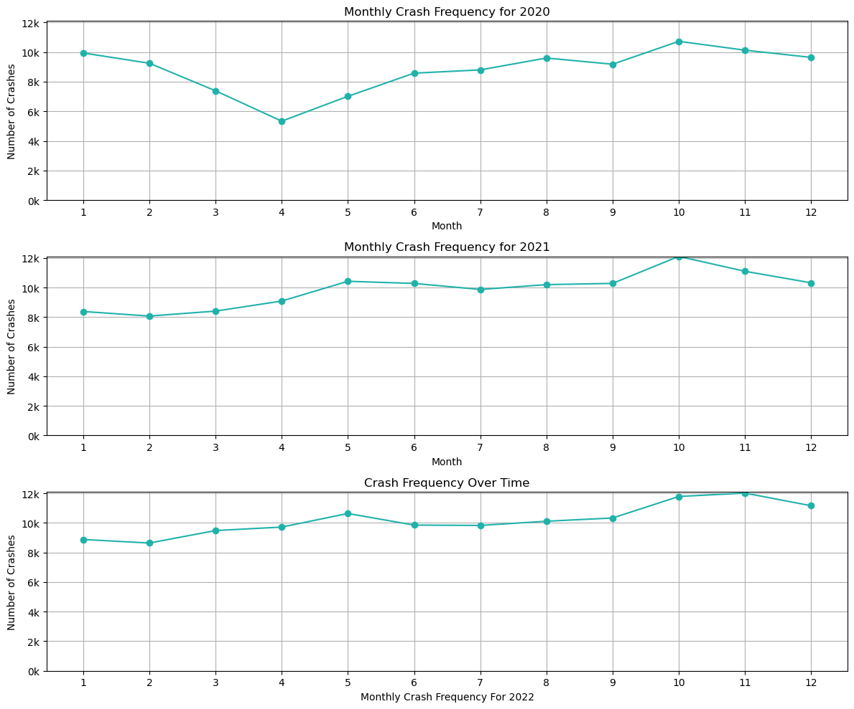
what are the differences in crash pattern based on the presence of work zones and school zones?
How has the frequency of crashes varied over time?
Over the last 10 years, 8,034 people were killed in crashes on Virginia roadways. Of those deaths, 791 - 10% - occurred in October, making it statistically the most dangerous month of the year for crash fatalities.

Slide 4
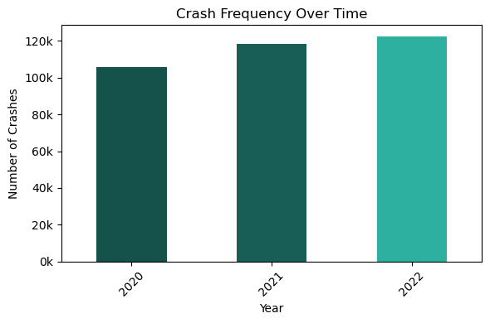
How has the frequency and severity of crashes varied over the years?
In 2022 there was significant increase in the number of crash severity compared to 2020 and 2021 .
In 2022, Virginia's traffic deaths increased to a 15-year high. Some reasons for the increase include:
Driver error: Driver error is the most common cause of car accidents in Virginia.
Speeding: More Virginians are dying in speed-related crashes.
Drunk driving: Drunk driving may also be the other driver error factor.
Not wearing seatbelts: People not using seatbelts may be a factor.

Slide 5
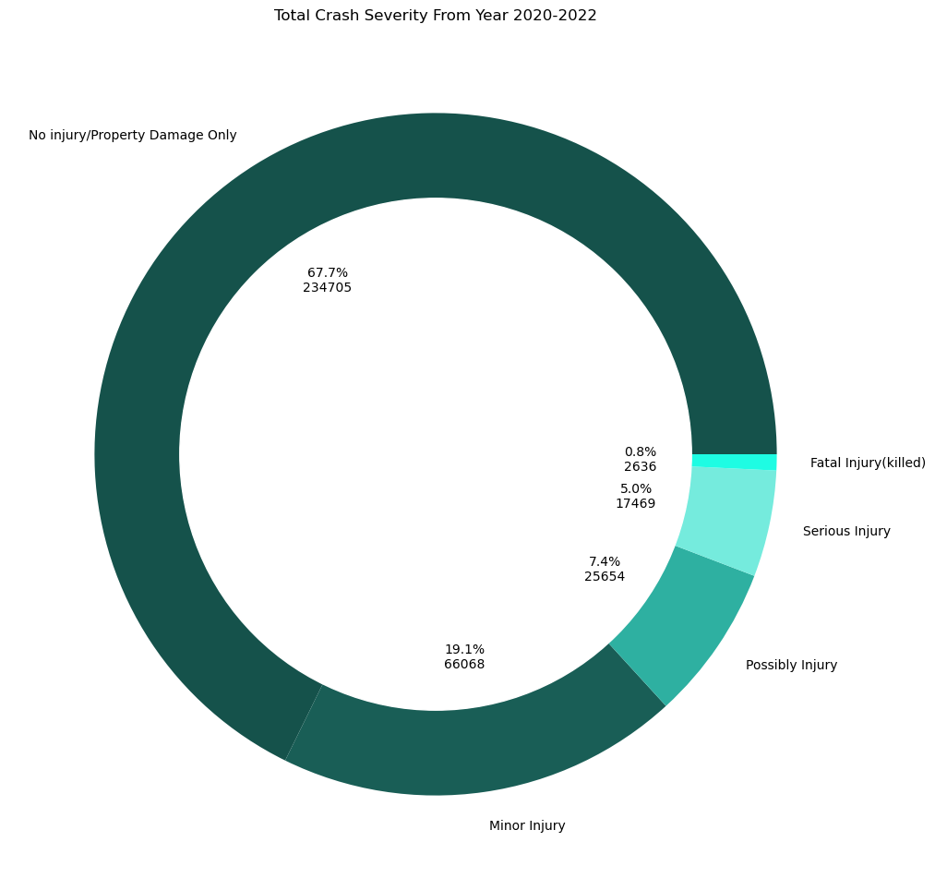
Total Crash Severity From Year 2020 - 2022
Based on the total crash severity distribution represented in a donut chart, the Number of crash involved No injuries at the scene is the highest i.e. 67.7%

Slide 6
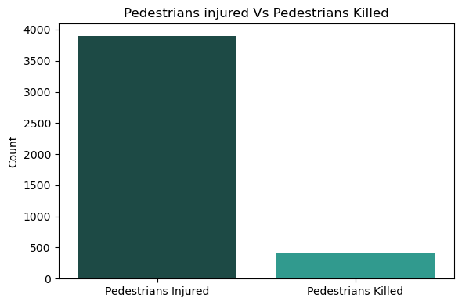
Total count of pedestrian injured Vs killed
Here it shows count of Pedestrian injured is higher than killed.

Slide 7
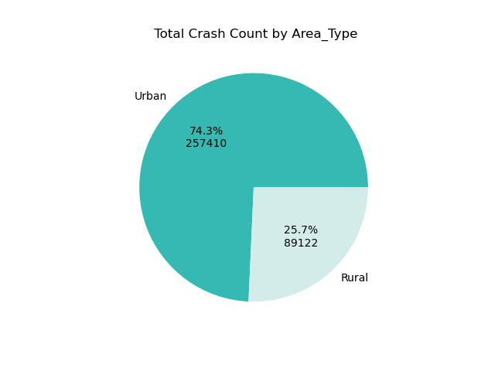
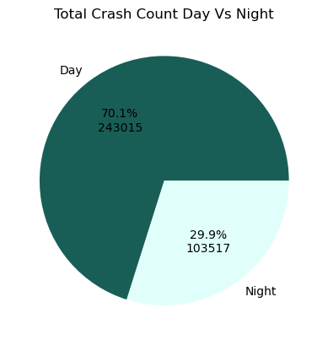
Total Crash count based on Area Type and Daytime vs Nighttime
Conclusion: Almost one third Of the crashes happened in urban area and during daytime.

Slide 8
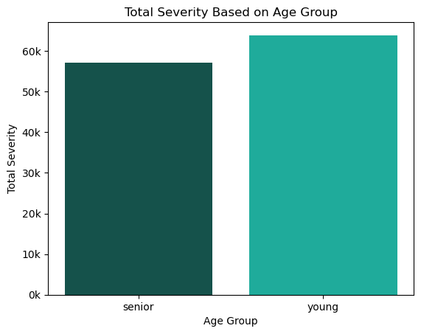
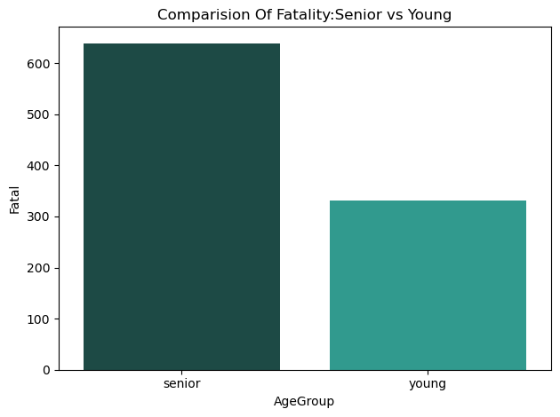
Are there distinct patterns in crash occurrences and severity based on the age groups of those involved (senior vs young)?
The chart below senior age group has a higher involvement in the fatal crash over the Young.
Here also shows Young age group has a higher involvement in the total crash over the seniors.

Slide 9
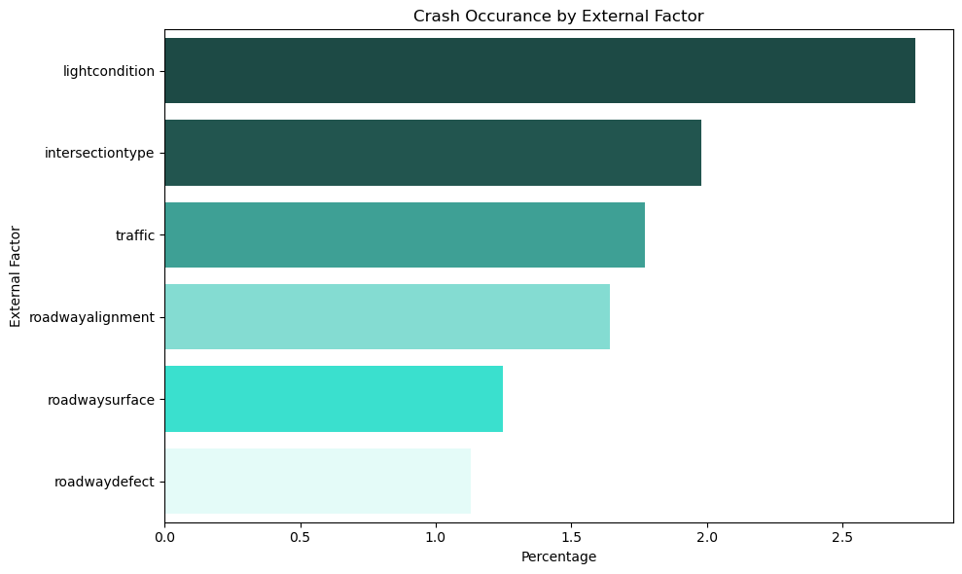
What are the primary contributing factors to crashes in Virginia?
Based on the chart:
1- The First Factor is due to “light conditions”. Poor lighting, especially during nighttime or adverse weather conditions
2 .The Second one is due to “intersection type“, which is the design and control measures at intersection can influence crash rates
3. The third one is due to “traffic“,
This refers to the presence(or absence) and type of traffic control devices at a location, such as stop signs ,traffic signals, yield signs or traffic circles.

Slide 10
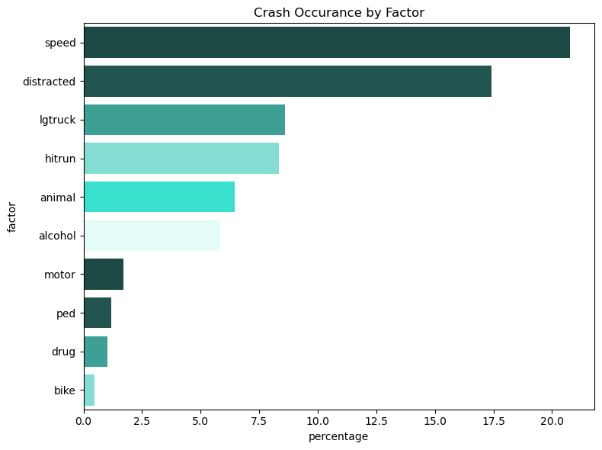
What are the primary contributing factors to crashes in Virginia?
Among these factors the highest percent of crashes is attributed to speeding, followed by distracted driving and with large truck.
This suggest that drivers driving traveling at high speeds are more likely to lose control or have less time to react to road conditions or action of other drivers, leading to a higher incidence of crashes.
Distracted driving, which can include texting, using a phone, adjusting the radio ,or other activities that take the drivers attention away from the road, it also a significant contributor to accidents.

Slide 11
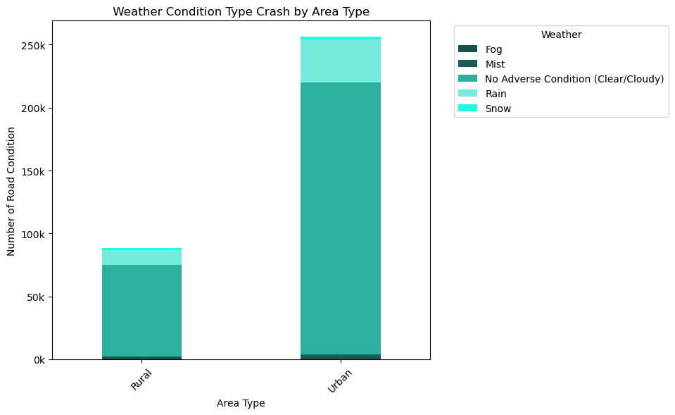
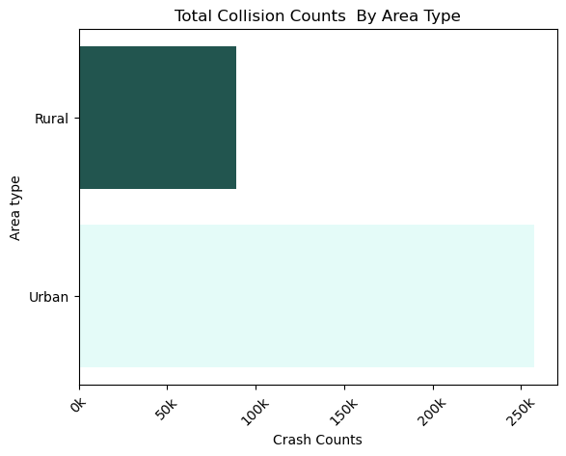
Weather Related Type Crash by Area type
The plot indicates both urban and rural areas in Virginia experience a notable number of crashes due to adverse weather conditions, specifically in snow and rain.

Slide 12
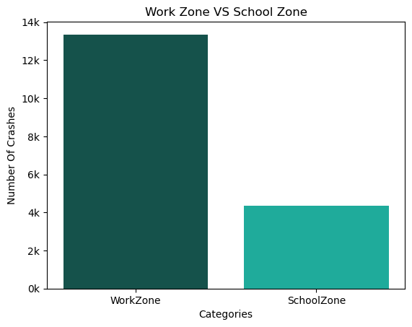
What are the differences in crash pattern based on the presence of work zones and school zones?
Work zones have more crashes
due to construction,
lane changes, and speed fluctuations, school zone have fewer due to lower speeds and heightened caution.

Slide 13

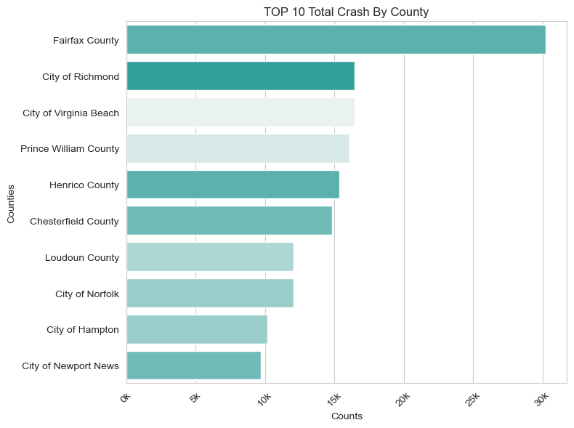
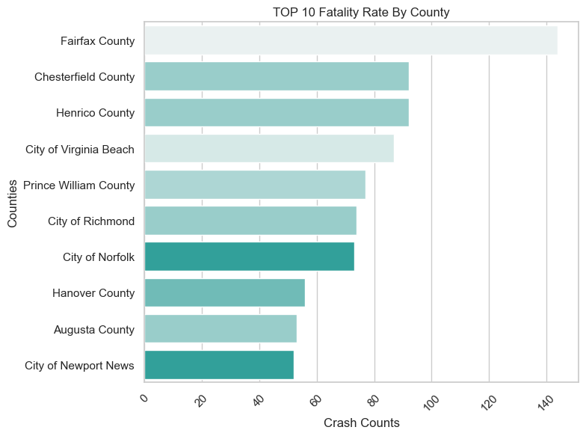
Top ten counties with count of crashes resulting in fatality
Here are the top ten counties with total crash
In both sicarios Fairfax county shows the highest in the count of crashes.

Slide 14
A color density map showing total crash frequencies through out Virginia
With the Fairfax county the darkest which is the highest count.

Slide 16

Conclusion/ Recommendations
In conclusion, my analysis of the state of Virginia counties' crash data from 2020 to 2022 has provided valuable insights into traffic safety issues within the state.
We identified
high-risk counties,
times, and
conditions contributing to crashes, with driver behavior and environmental factors playing significant roles.
The findings suggest a need for targeted safety measures, such as
Enhanced road maintenance,
Stricter enforcement of traffic laws, and
Public education on safe driving practices.
My analysis supports the creation of data-driven policies and interventions to improve road safety and reduce the incidence of traffic-related injuries and fatalities across Virginia. Continued monitoring and analysis are crucial for the ongoing success of these initiatives.

Slide 17


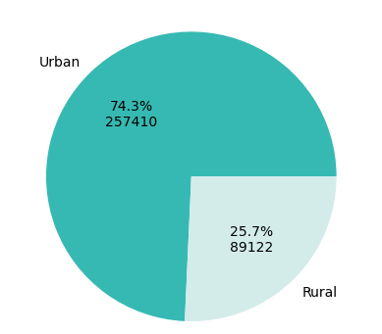
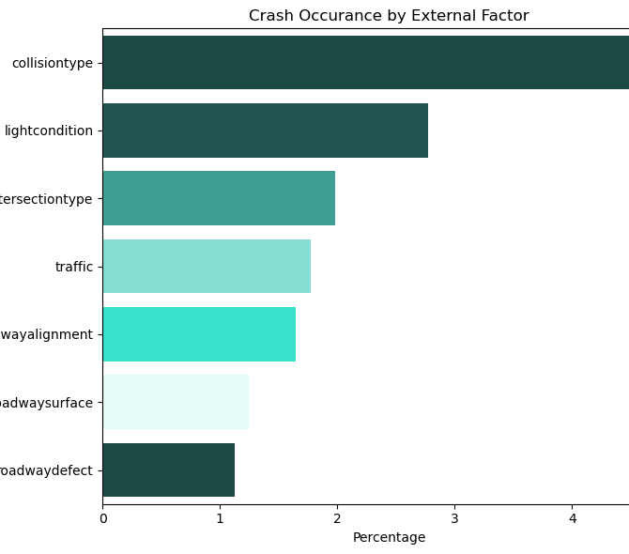
Thank you!
Data source
Business dataset: https://data.virginia.gov/Transportation/Open-View-VA-Department-of-Transportation-Crash-Data/q3i7-ztj9/about_data
Geo-JSON dataset: https://data.virginia.gov/dataset/county-fiscal-stress-2021
Selamawit Mekonnen
2024

